Slide 1
CMPM163 Ambient Occlusion
Jason Chen, Jacob Daniels-Flechtner, Taylor Infuso,
Oskar Alfaro, Junhao Su

Slide 2
Goals
We desire nicer looker lighting than Unity’s built in options.
Initially desired indirect lighting but required too many raycasts and computational power.
Settled for custom ambient occlusion due to it being more efficient.
Also, we want to include smoother shading.
Finally, we are making a scene using other visual effects, including smoke.

Slide 3
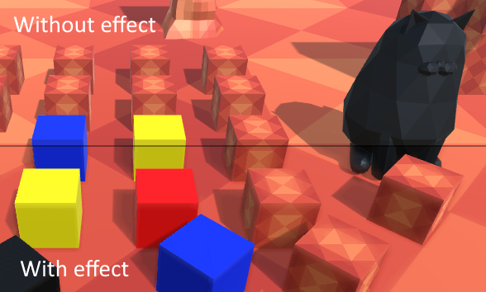
Early Build

Slide 4
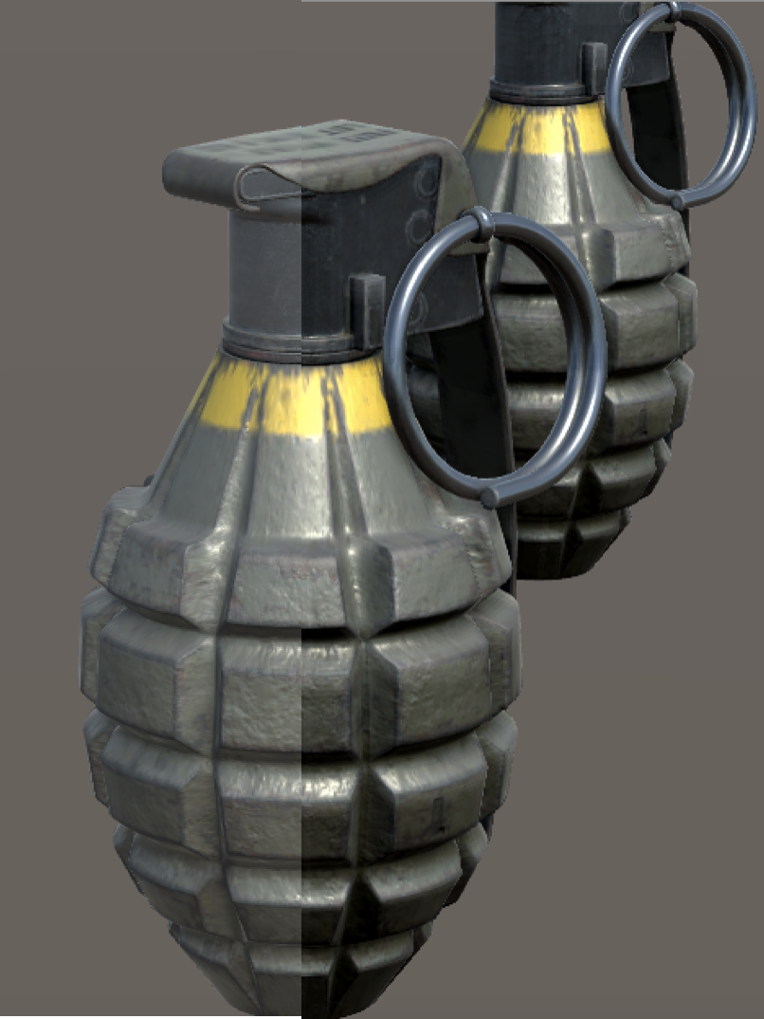
Without effect
With effect
Current Build

Slide 5
Our Process for Ambient Occlusion
Receive depth buffer from camera.
For each texel, query surrounding texels within a range.
If the surrounding texels are closer to the camera than the root texel, we make the root texel darker.
We avoid checking texels above the root texel.
Blend together darker surfaces that are flat.
Done checking the differences of depth between surrounding texels.
Combine blended color with darker texel color.

Slide 6
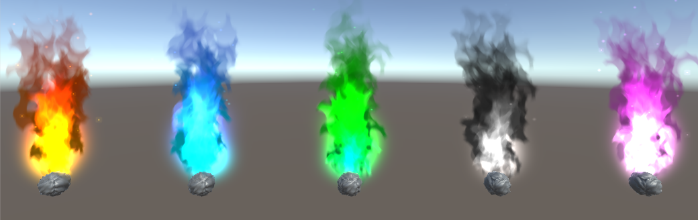
Additional Effects

Slide 7
Our Process for Particle Effects
Created parent objects with multiple layers of color, noise (for sparks), size, etc. and overlapped them. Uses inspiration from the HW.
Created a material and assigned a fire texture onto it.
Adjust size and shape of four overlapping particle effects until we found the results we were looking for.

Slide 8
Challenges
We attempted to implement custom shadows via two methods.
Using a green screen to indicate areas for generating shadows. Left behind too many artifacts.
Used raycasts from light to objects to indicate areas for shadows. Too much slowdown.
Ambient occlusion is not strong enough. Strengthening the effect leads to inaccuracies.
Querying large amounts of texels is inefficient.

Slide 9
Tasks
Jason: Perfecting ambient occlusion
Jacob: Perfecting ambient occlusion
Taylor: Make a scene and work on shadows
Oskar: Smoke shader
Jun: Smoke shader and vertex displacement animation

